Slide 1
Oregon Battle of the Books
2024-2025
6th-8th Grade Division

Slide 2
What is OBOB?
OBOB stands for Oregon Battle of the Books!
The Battle of the Books is a friendly reading competition. You will get into teams of 4-5 students and read a list of 16 books. You do NOT have to read all 16 unless you want to! I suggest reading about 4 or 5 of the books. To battle, your team will compete against one other team answering questions about the books from the list.
Team sign up will begin in October, and ACCESS OBOB battles will be sometime in February!

Slide 3
The Books!

Slide 4
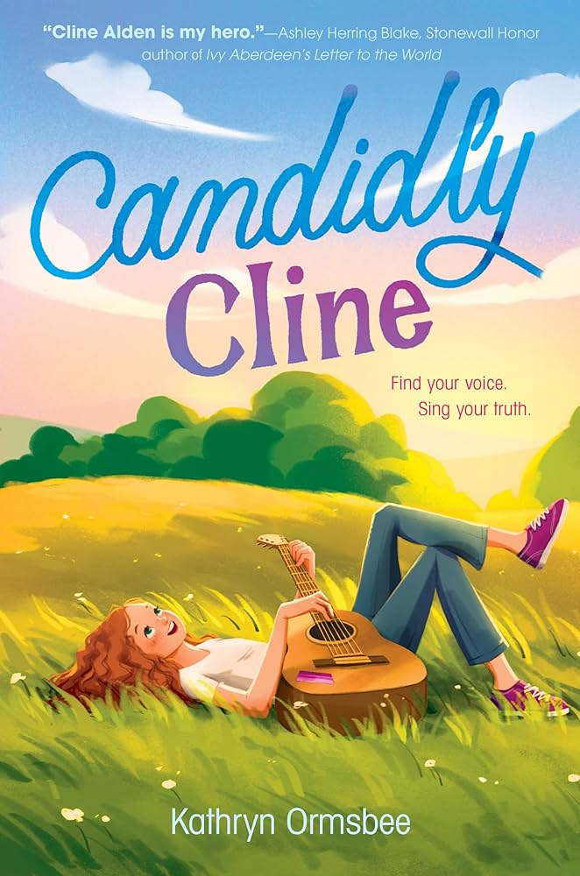
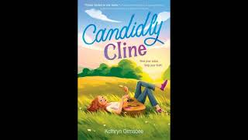
Candidly Cline
by Kathryn Ormsbee
Born in Paris, Kentucky, and raised on her gram’s favorite country music, Cline Alden is a girl with big dreams and a heart full of song. When she finds out about a young musicians’ workshop a few towns over, Cline sweet-talks, saves, and maybe fibs her way into her first step toward musical stardom.
But her big dreams never prepared her for the butterflies she feels surrounded by so many other talented kids—especially Sylvie, who gives Cline the type of butterflies she’s only ever heard about in love songs.
As she learns to make music of her own, Cline begins to realize how much of herself she’s been holding back. But now, there’s a new song taking shape in her heart—if only she can find her voice and sing it.

Slide 5
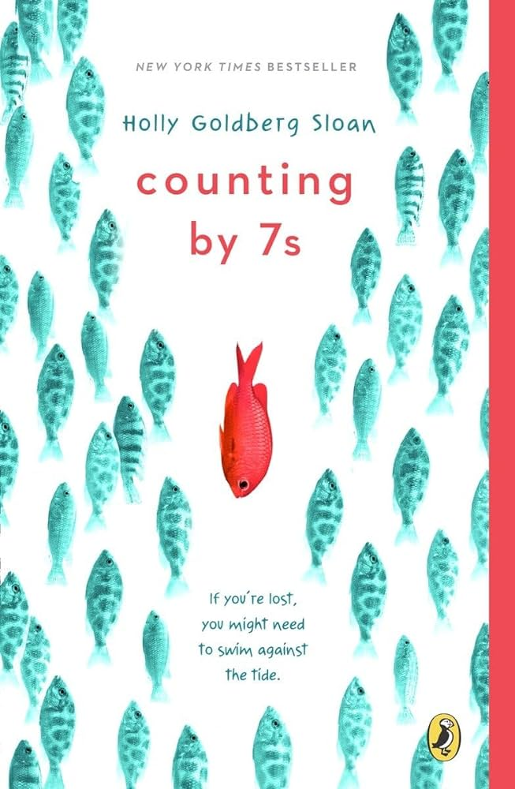
Counting by 7s
by Holly Goldberg Sloan
Counting by 7s tells the story of Willow Chance, a twelve-year-old genius who is obsessed with diagnosing medical conditions and finds comfort in counting by 7s. It has never been easy for her to connect with anyone other than her adoptive parents, but that hasn't kept her from leading a quietly happy life . . . until now.
Suddenly Willow's world is tragically changed when her parents both die in a car crash, leaving her alone in a baffling world. Her journey to find a fascinatingly diverse and fully believable surrogate family is a joy and a revelation to read.

Slide 6
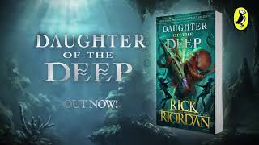
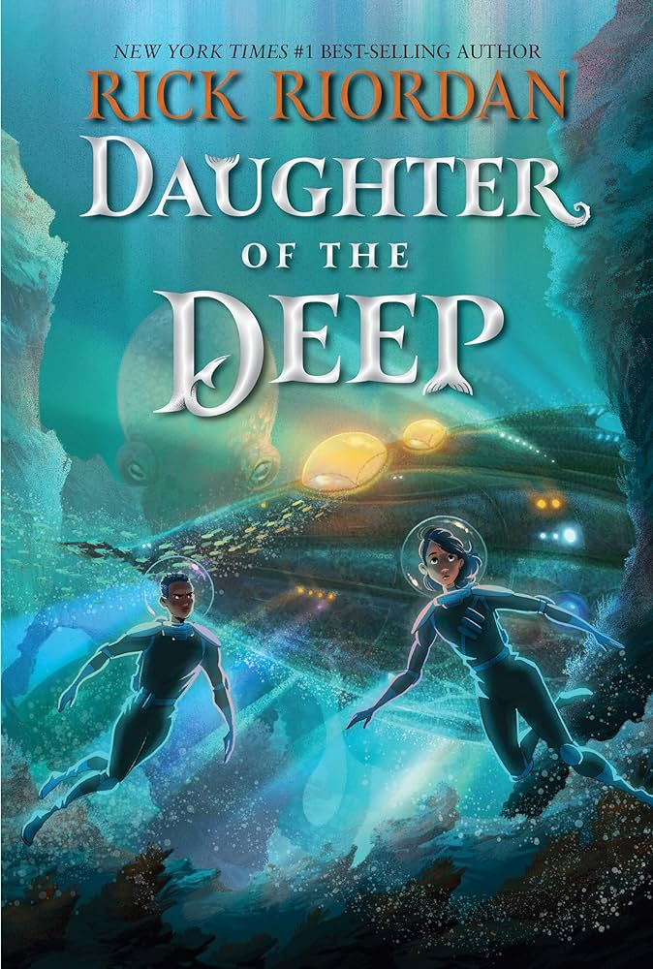
Daughter of the Deep
by Rick Riordan
Ana Dakkar is a freshman at Harding-Pencroft Academy, a five-year high school that graduates the best marine scientists, naval warriors, navigators, and underwater explorers in the world. Ana's parents died while on a scientific expedition two years ago, and the only family she's got left is her older brother, Dev, also a student at HP. Ana's freshman year culminates with the class's weekend trial at sea, the details of which have been kept secret. She only hopes she has what it'll take to succeed. All her worries are blown out of the water when, on the bus ride to the ship, Ana and her schoolmates witness a terrible tragedy that will change the trajectory of their lives.
But wait, there's more. The professor accompanying them informs Ana that their rival school, Land Institute, and Harding-Pencroft have been fighting a cold war for a hundred and fifty years. Now that cold war has been turned up to a full broil, and the freshmen are in danger of becoming fish food. In a race against deadly enemies, Ana will make amazing friends and astounding discoveries about her heritage as she puts her leadership skills to the test for the first time.

Slide 7
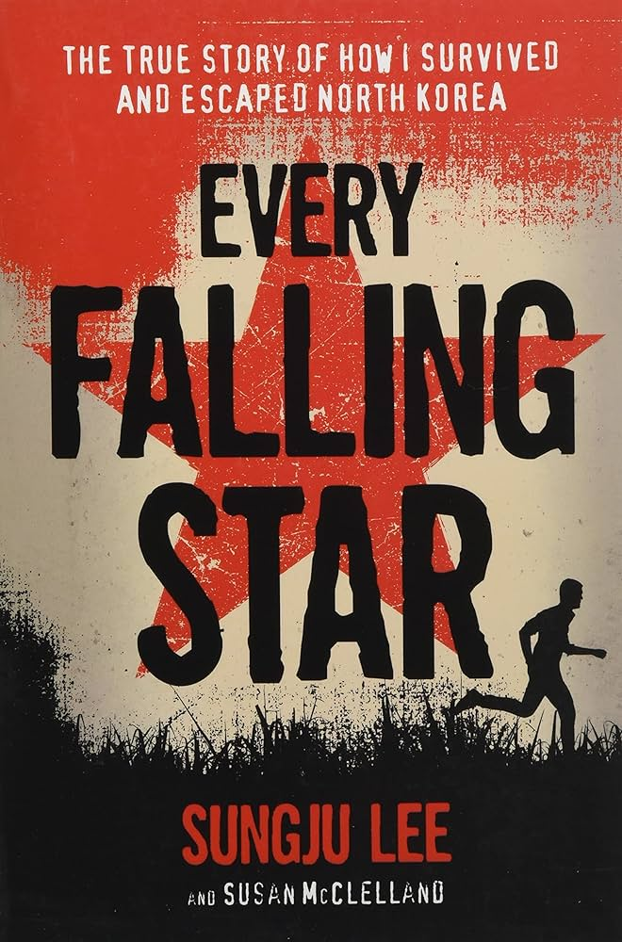
Every Falling Star by Sungju Lee & Susan McClelland
Every Falling Star, the first book to portray contemporary North Korea to a young audience, is the intense memoir of a North Korean boy named Sungju who is forced at age twelve to live on the streets and fend for himself. To survive, Sungju creates a gang and lives by thieving, fighting, begging, and stealing rides on cargo trains. Sungju richly re-creates his scabrous story, depicting what it was like for a boy alone to create a new family with his gang, his 'brothers'; to be hungry and to fear arrest, imprisonment, and even execution. This riveting memoir allows young readers to learn about other cultures where freedoms they take for granted do not exist.

Slide 8
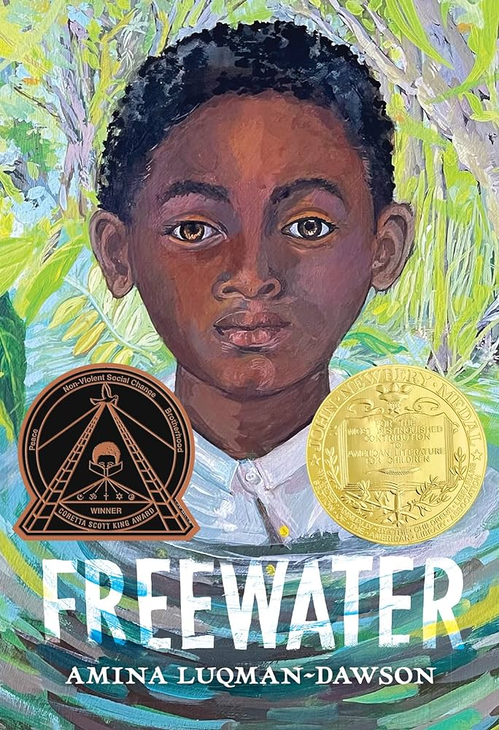
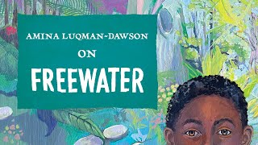
Freewater by Amina Luqman-Dawson
Under the cover of night, twelve-year-old Homer flees Southerland Plantation with his little sister Ada, unwillingly leaving their beloved mother behind. Much as he adores her and fears for her life, Homer knows there’s no turning back, not with the overseer on their trail. Through tangled vines, secret doorways, and over a sky bridge, the two find a secret community called Freewater, deep in the swamp.
In this society created by formerly enslaved people and some freeborn children, Homer finds new friends, almost forgetting where he came from. But when he learns of a threat that could destroy Freewater, he crafts a plan to find his mother and help his new home.

Slide 9
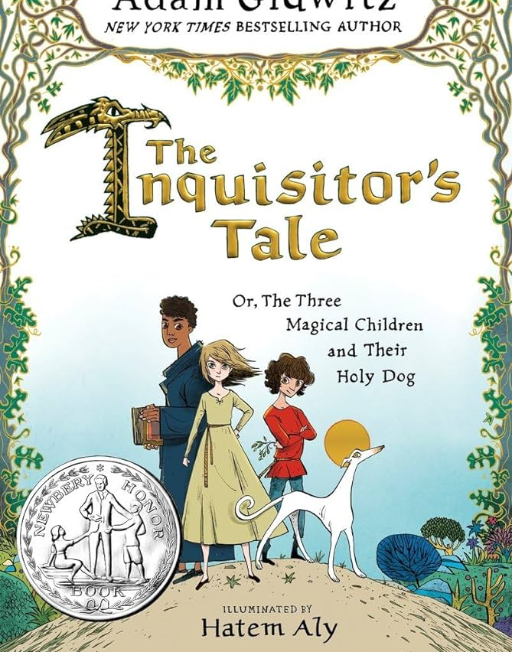
The Inquisitor’s Tale
by Adam Gidwitz
The year is 1242. On a dark night, travelers from across France cross paths at an inn and begin to tell stories of three children. Their adventures take them on a chase through France: they are taken captive by knights, sit alongside a king, and save the land from a farting dragon. On the run to escape prejudice and persecution and save precious and holy texts from being burned, their quest drives them forward to a final showdown at Mont Saint-Michel, where all will come to question if these children can perform the miracles of saints. Told in multiple voices, in a style reminiscent of The Canterbury Tales, our narrator collects their stories and the saga of these three unlikely allies begins to come together.

Slide 10
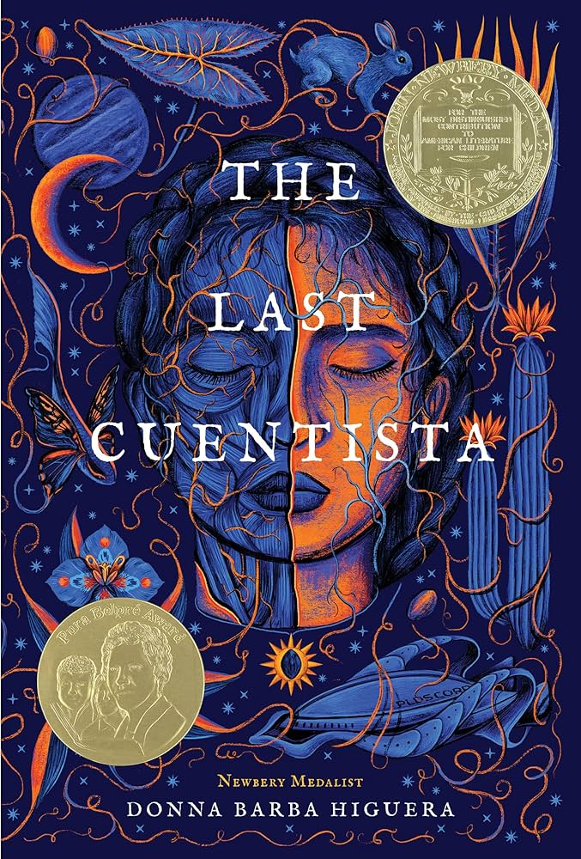
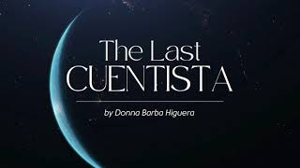
The Last Cuentista
by Donna Barba Higuera
There lived a girl named Petra Peña, who wanted nothing more than to be a storyteller, like her abuelita.
But Petra's world is ending. Earth has been destroyed by a comet, and only a few hundred scientists and their children – among them Petra and her family – have been chosen to journey to a new planet. They are the ones who must carry on the human race.
Hundreds of years later, Petra wakes to this new planet – and the discovery that she is the only person who remembers Earth. A sinister Collective has taken over the ship during its journey, bent on erasing the sins of humanity's past. They have systematically purged the memories of all aboard – or purged them altogether.
Petra alone now carries the stories of our past, and with them, any hope for our future. Can she make them live again?

Slide 11
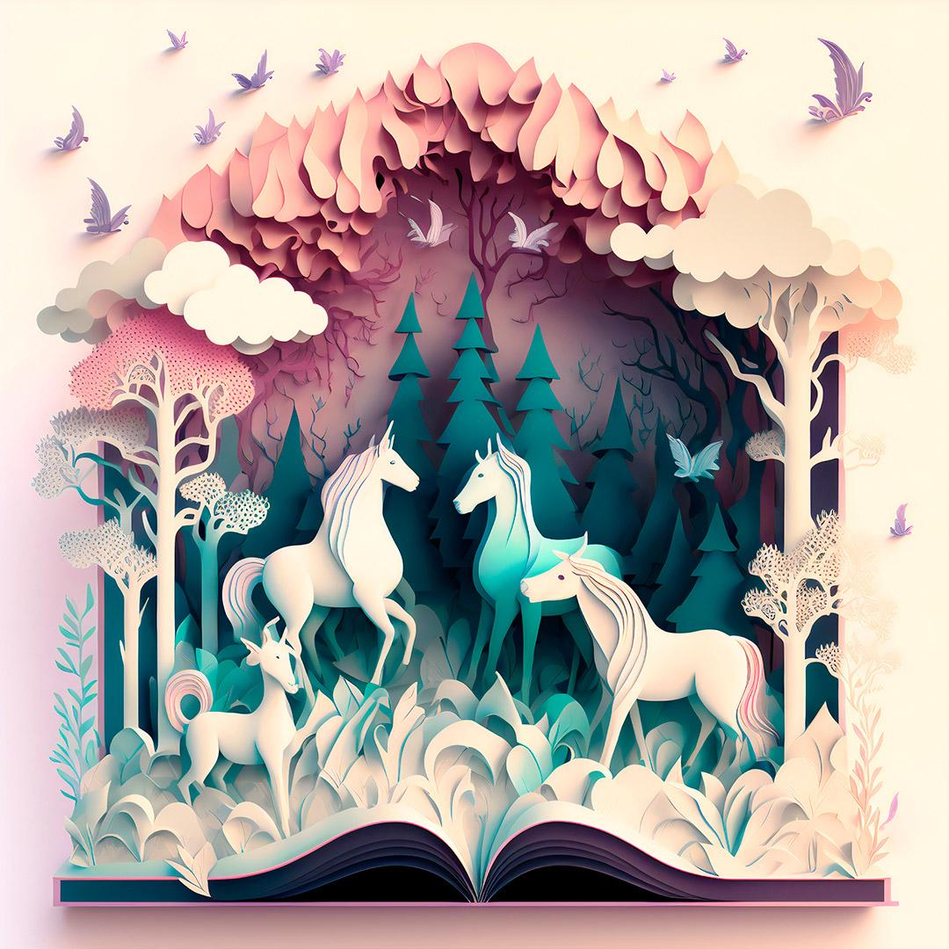
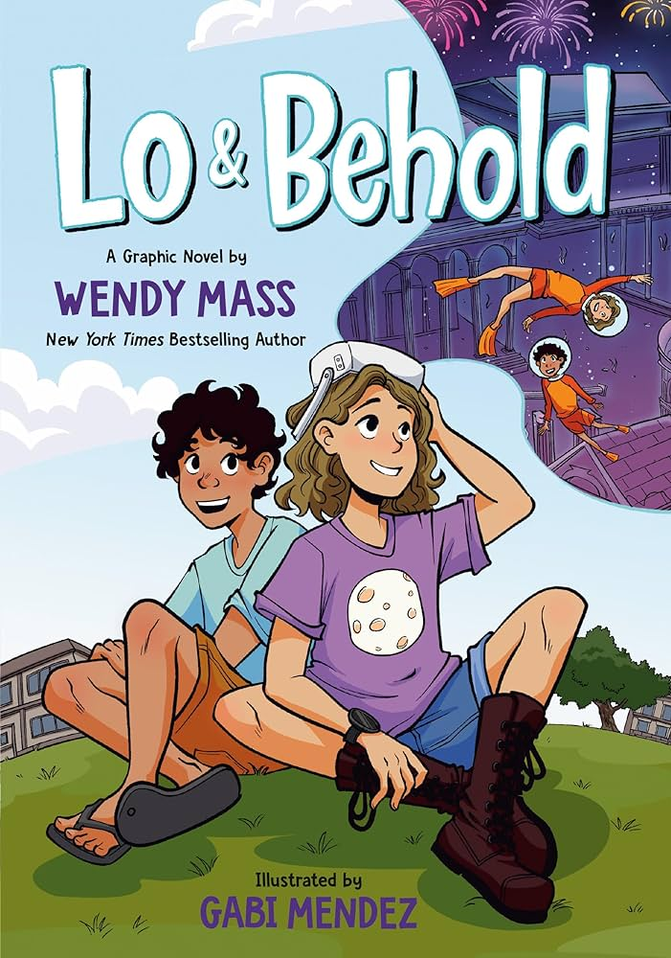
Lo & Behold by Wendy Mass and Gabi Mendez
When you’re named after a 250-year-old tortoise, you grow up believing life is full of possibilities and wonder. But ever since Addie’s family got turned upside down, those things have been harder for her to see.
The last thing Addie wants to do is make a new friend, but when her dad’s summer job takes them across the country, she meets Mateo and finds herself caught up in an exciting project. With the help of a virtual reality headset, she’s suddenly scaling castle walls, dodging angry kittens, and seeing the world in whole new ways. Plus, she has an idea that could be bigger than anything she’s imagined before, but can she right some wrongs first . . . or is it too late?

Slide 12
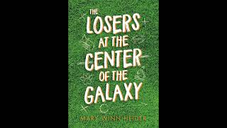
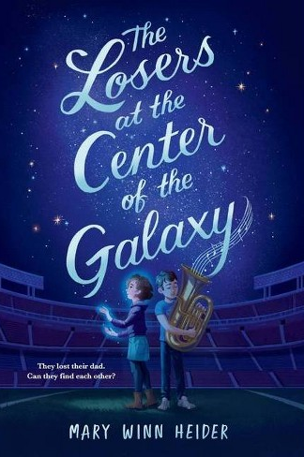
The Losers at the Center of the Galaxy by Mary Winn Heider
A tuba player without a tuba and his jellyfish-imitating sister cope with their father's disappearance in this hilarious and moving novel by the author of The Mortification of Fovea Munson.
When Lenny Volpe, former quarterback of the worst professional football team in the nation, leaves his family and disappears, the Chicago Horribles win their first game in a long time. Fans are thrilled. The world seems to go back to normal. Except for the Volpe kids.
Winston throws himself into playing the tuba, and Louise starts secret experiments to find a cure for brain injuries, and they're each fine, just fine, coping in their own way. That is, until the investigation of some eccentric teacher behavior and the discovery of a real live bear paraded as the Horribles' new mascot make it clear that things are very much Not Fine. The siblings may just need each other, after all.

Slide 13
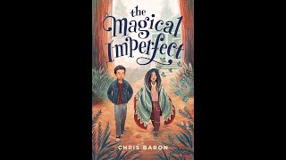
The Magical Imperfect
by Chris Baron
Etan has stopped speaking since his mother left. His father and grandfather don’t know how to help him. His friends have given up on him.
When Etan is asked to deliver a grocery order to the outskirts of town, he realizes he’s at the home of Malia Agbayani, also known as the Creature. Malia stopped going to school when her acute eczema spread to her face, and the bullying became too much.
As the two become friends, other kids tease Etan for knowing the Creature. But he believes he might have a cure for Malia’s condition, if only he can convince his family and hers to believe it too. Even if it works, will these two outcasts find where they fit in?

Slide 14
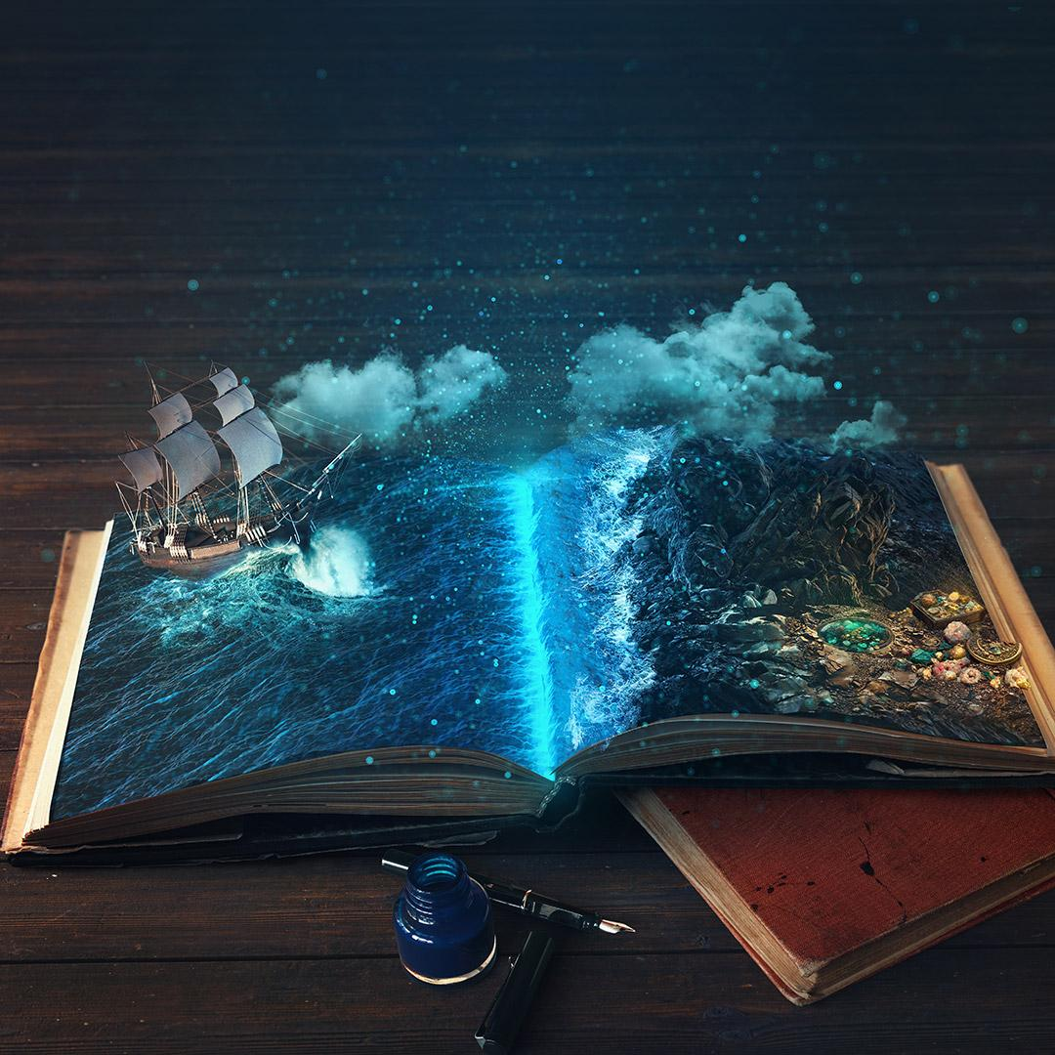
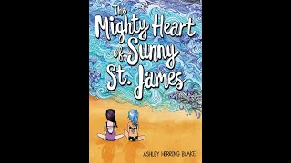
The Mighty Heart of Sunny St. James by Ashley Herring Blake
Twelve-year-old Sunny St. James navigates heart surgery, reconnecting with her lost mother, first kisses, and emerging feelings for another girl in this stunning, heartfelt novel--perfect for fans of Erin Entrada Kelly. When Sunny St. James receives a new heart, she decides to set off on a "New Life Plan": 1) do awesome amazing things she could never do before; 2) find a new best friend; and 3) kiss a boy for the first time.
Everything seems to be racing forward, but when she meets Quinn, Sunny questions whether she really wants to kiss a boy at all. And with the reemergence of her mother, Sunny's journey to becoming the new Sunny St. James will be trickier than expected. Acclaimed author Ashley Herring Blake's sweet, tender novel will dare readers to find the might in their own hearts.

Slide 15
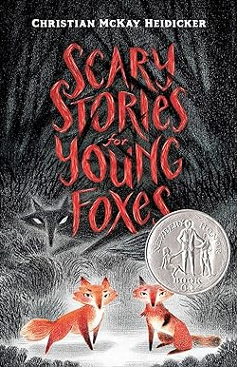
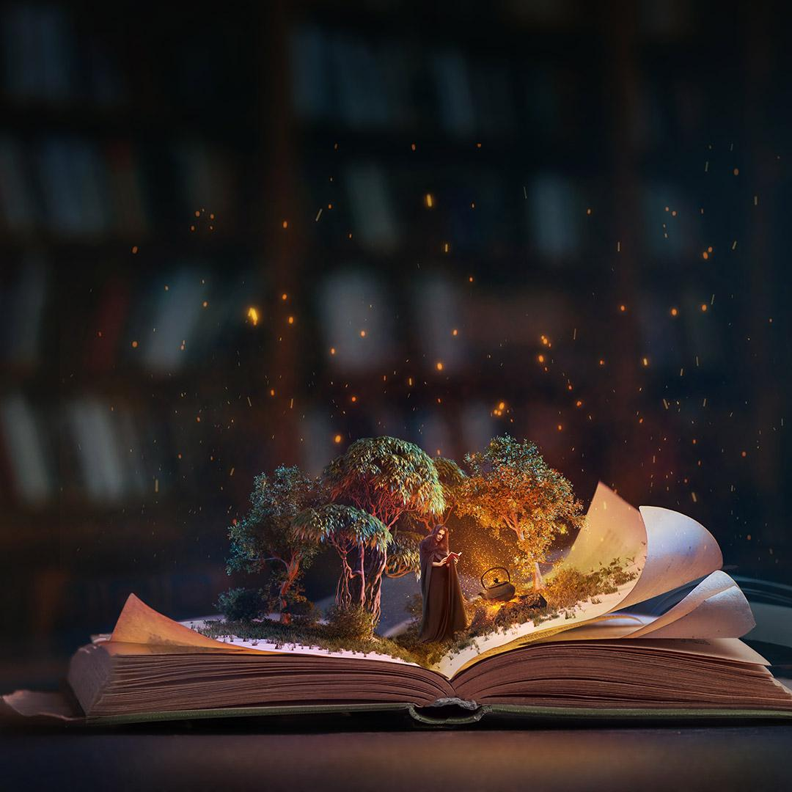
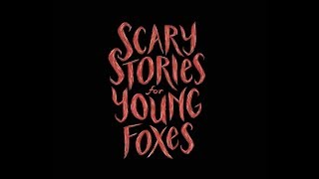
Scary Stories for Young Foxes by Christian McKay Heidicker
The haunted season has arrived in the Antler Wood. No fox kit is safe.
When Mia and Uly are separated from their litters, they discover a dangerous world full of monsters. In order to find a den to call home, they must venture through field and forest, facing unspeakable things that dwell in the darkness: a zombie who hungers for their flesh, a witch who tries to steal their skins, a ghost who hunts them through the snow . . . and other things too scary to mention.

Slide 16
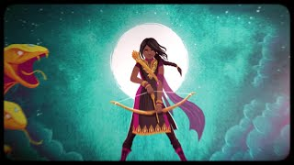
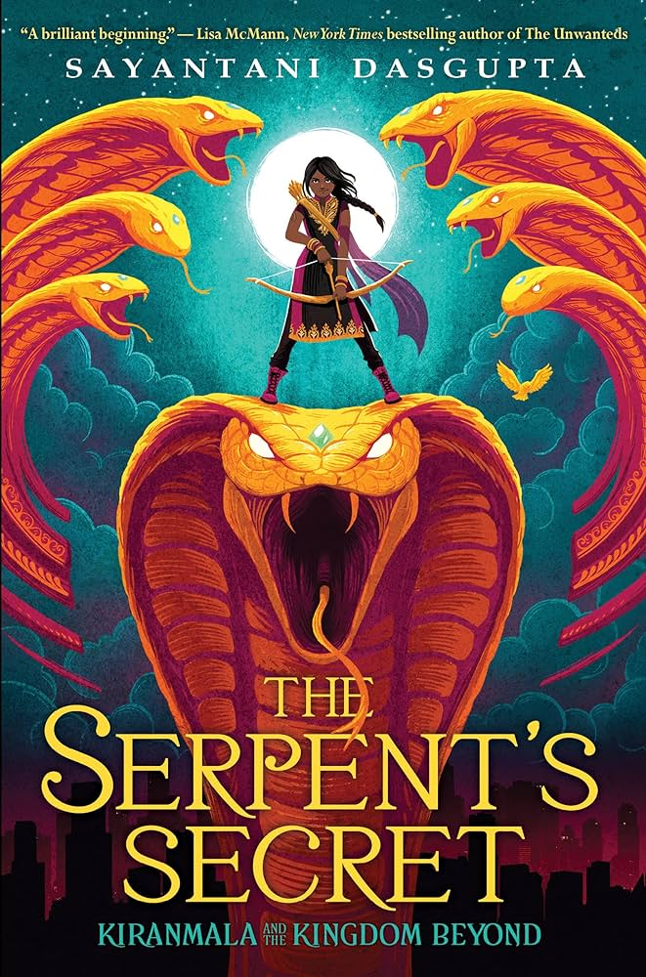
The Serpent’s Secret
by Sayantani DasGupta
On the morning of her twelfth birthday, Kiranmala is just a regular sixth grader living in Parsippany, New Jersey... until her parents mysteriously vanish and a drooling rakkhosh demon slams through her kitchen, determined to eat her alive. Turns out there might be some truth to her parents' fantastical stories-like how Kiranmala is a real Indian princess and how she comes from a secret place not of this world.
To complicate matters, two crush-worthy princes ring her doorbell, insisting they've come to rescue her. Suddenly, Kiran is swept into another dimension full of magic, winged horses, moving maps, and annoying, talking birds. There she must solve riddles and battle demons all while avoiding the Serpent King of the underworld and the Rakkhoshi Queen in order to find her parents and basically save New Jersey, her entire world, and everything beyond it...

Slide 17
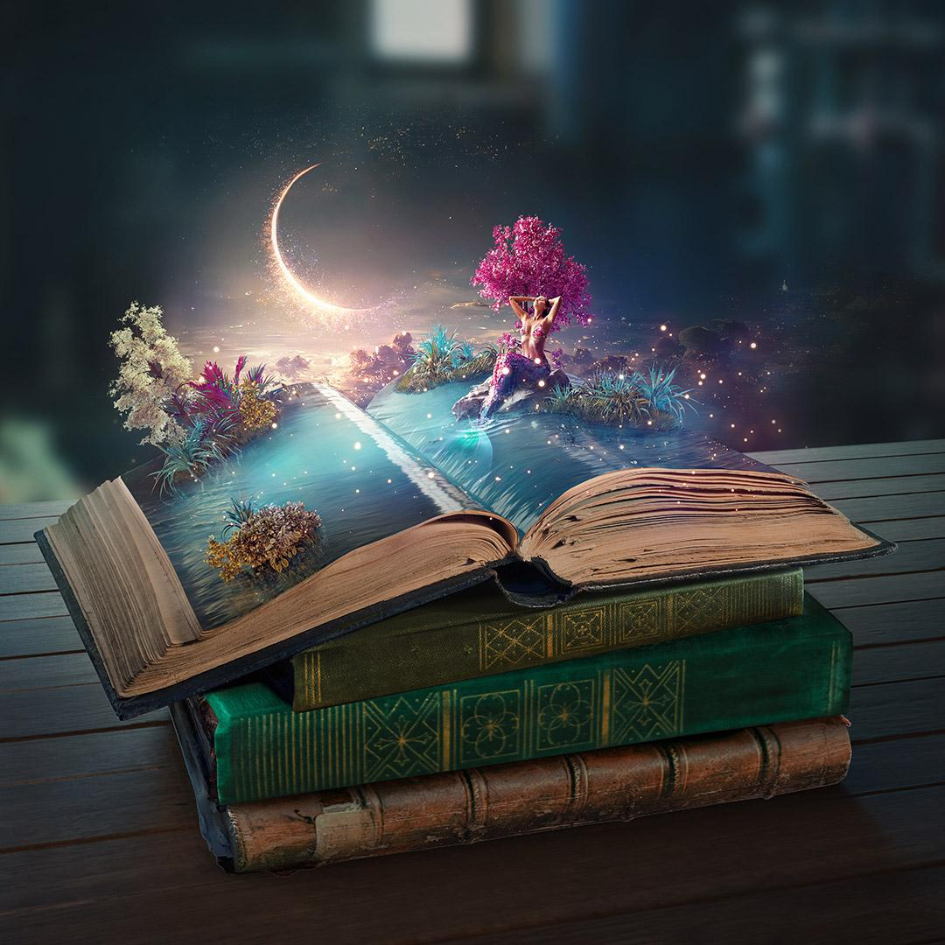
Starfish by Lisa Fipps
Ever since Ellie wore a whale swimsuit and made a big splash at her fifth birthday party, she’s been bullied about her weight. To cope, she tries to live by the Fat Girl Rules—like “no making waves,” “avoid eating in public,” and “don’t move so fast that your body jiggles.” And she’s found her safe space—her swimming pool—where she feels weightless in a fat-obsessed world. In the water, she can stretch herself out like a starfish and take up all the room she wants. It’s also where she can get away from her pushy mom, who thinks criticizing Ellie’s weight will motivate her to diet. Fortunately, Ellie has allies in her dad, her therapist, and her new neighbor, Catalina, who loves Ellie for who she is. With this support buoying her, Ellie might finally be able to cast aside the Fat Girl Rules and starfish in real life—by unapologetically being her own fabulous self.

Slide 18
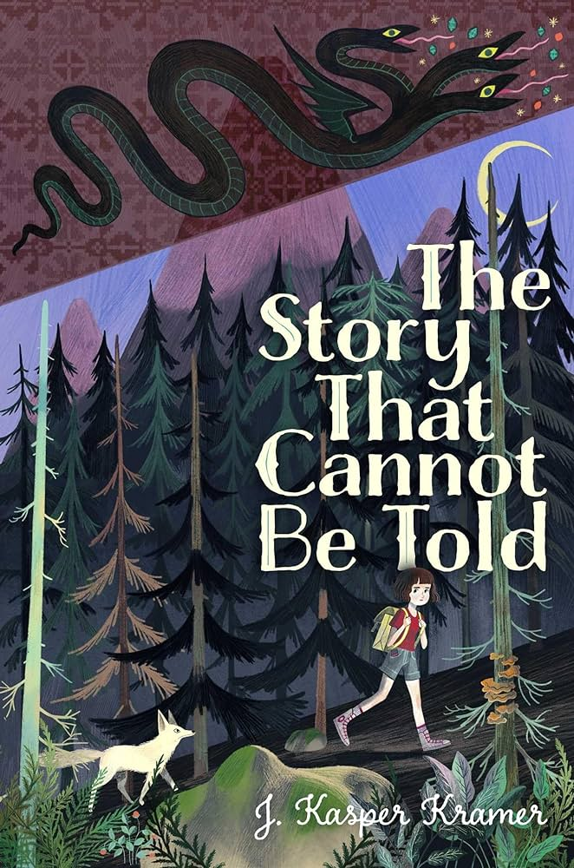
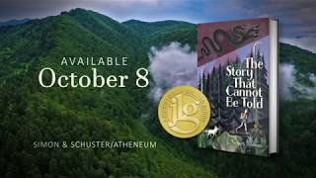
The Story That Cannot be Told by J. Kasper Kramer
Ileana has always collected stories. Some are about the past, before the leader of her country tore down her home to make room for his golden palace; back when families had enough food, and the hot water worked on more than just Saturday nights. Others are folktales like the one she was named for, which her father used to tell her at bedtime. But some stories can get you in trouble, like the dangerous one criticizing Romania’s Communist government that Uncle Andrei published—right before he went missing.
Fearing for her safety, Ileana’s parents send her to live with the grandparents she’s never met, far from the prying eyes and ears of the secret police and their spies, who could be any of the neighbors. But danger is never far away. Now, to save her family and the village she’s come to love, Ileana will have to tell the most important story of her life.

Slide 19
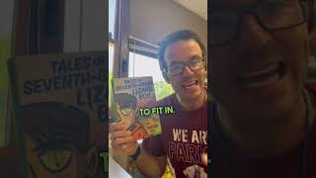
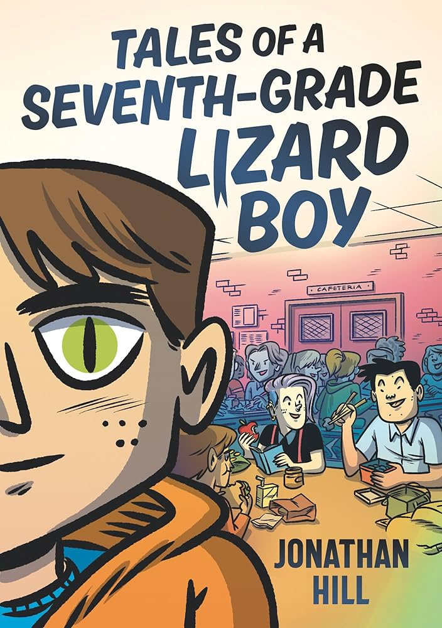
Tales of a Seventh-Grade Lizard Boy by Jonathan Hill
Threatened with diminishing resources, Booger Lizk’t and his family flee their lizard community deep below Earth’s crust to survive above among humans. The Lizk’t family of Elberon now passes as the Tomkins family of Eagle Valley. “Tommy Tomkins” wears a human face to school but can’t seem to fit in no matter how he looks. The basketball team becomes a pipe dream when bullies label him a bug eater, and only Dung Tran, an immigrant from Vietnam and fellow outsider, sees Tommy for who he is inside, which is nothing like the outer-space lizard invaders on TV’s hottest series. Can their friendship survive the truth? In his first solo middle-grade book, award-winning creator Jonathan Hill perfectly captures the sometimes dystopian drama of middle school while reminding readers of the universal need for belonging.

